Slide 1
Prediction of stroke (ML 1003 Group 1)
Presented by:
Nonso Ukwuma
Vignesh Ram
Vinay Malik
Palash Patel

Slide 2
Outline
Introduction
Objective
Technique Used
Code and Insights
Conclusion

Slide 3
Introduction
Have you ever wondered if a machine could predict if a person can or cannot be affected by stroke?
Yes! You heard that right! With help of machine learning techniques, it is now possible! To put it into simpler terms we feed tons and tons of data to a model and let it work and do its magic.
In the project we are trying to predict if there is a potential that a person might be affected by stroke caused by his/her lifestyle.

Slide 4
Objectives
The objective of this project is to train a machine learning model to predict if the patient has or has the potential to suffer a Stroke or not using their existing records medical records.
The dataset which was gotten from Kaggle datasets is the medical records of 5110 in India and will be used to train and test our model.
The test labels for this project is binary {0, 1} which represents categories {yes, no} hence we will be training a Classification machine learning model using Logistic Regression.

Slide 5
Code Structure
Steps involved
Importing the required libraries for our analysis.
Data exploration and cleaning
Exploratory data analysis
Model training and prediction

Slide 6
Dataset Structure
Data columns (total 12 columns):
# Column Non-Null Count Dtype
--- ------ -------------- -----
0 id 5110 non-null int64
1 gender 5110 non-null object
2 age 5110 non-null float64
3 hypertension 5110 non-null int64
4 heart_disease 5110 non-null int64
5 ever_married 5110 non-null object
6 work_type 5110 non-null object
7 Residence_type 5110 non-null object
8 avg_glucose_level 5110 non-null float64
9 bmi 4909 non-null float64
10 smoking_status 5110 non-null object
11 stroke 5110 non-null int64

Slide 7
Data Cleaning
Our dataset contains some null values and other inconsistencies which we need to clean before proceeding with our analysis and model training. The following issues will be handled.
- Remove rows containing null values
- Change the data type for the Age column to integers
- The datasets captures records for 'Children' hence we will remove all records for children.
- Remove any records where the Age is less than 18 years as the chances of people below having stroke is quite low and hence not a good feature.
- Remove records where the BMI value is considered to be an outlier i.e. BMI is greater than 65.
- Remove 'ID' column as we do not need it for our prediction and its not a feature
- The gender feature contains a single entry for 'Other' hence we will remove it.

Slide 8
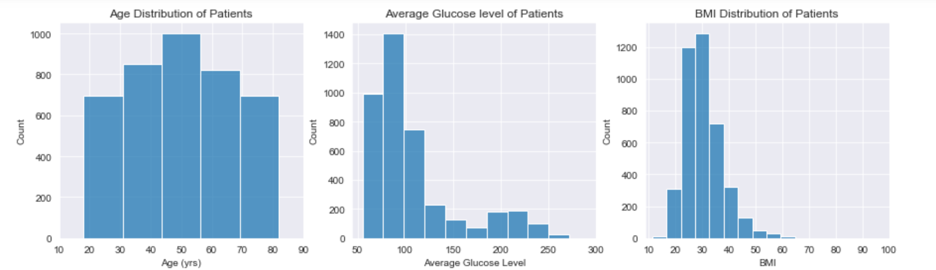
Exploratory Analysis - Univariate Analysis
- The majority of the patients are aged 44 - 56 years and more that 60% of the patients were under 60 years of age.
- The glucose levels for most of the patients was normal at values below 100.
- The BMI profile of the patients show that most of the patients (over 80%) had BMI above 22 which implies that they were mostly obese which is one of the factors that could lead to stroke.

Slide 9
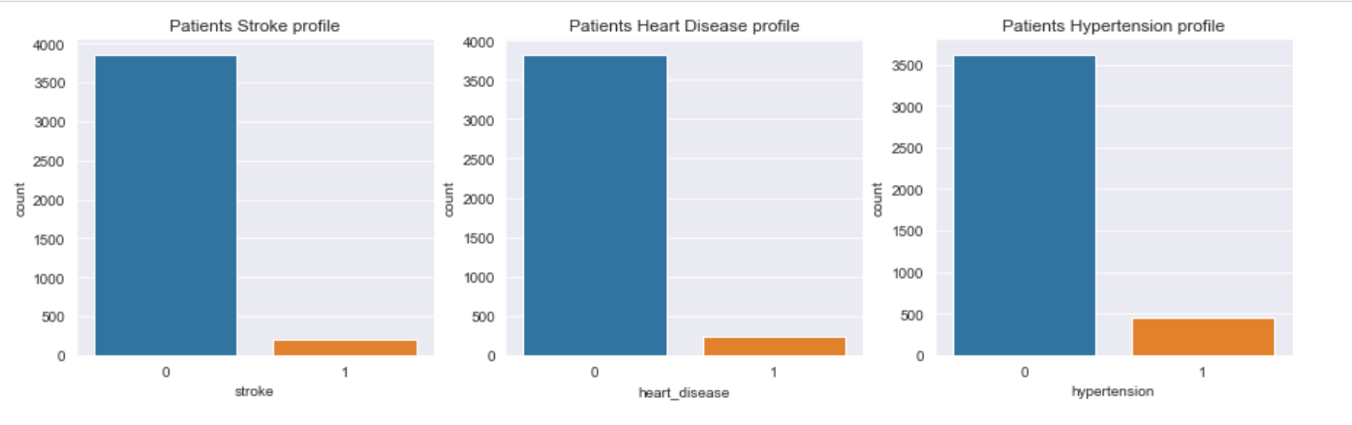
How many patients have Stroke, Heart Disease or Hypertension?
- The dataset contains very few patients who actually have stroke as we can see from the plot that the number of patients who have been diagnosed with stroke is less than 200. The occurrence of heart disease in the patients follows a similar pattern which could imply that there could be relationship.
- Almost 500 of the patients have hypertension and it could be possible that the patients who have stroke could be a subset of the patients with hypertension. What we can confirm from the plot is that all the patients who have hypertension do not have stroke.

Slide 10
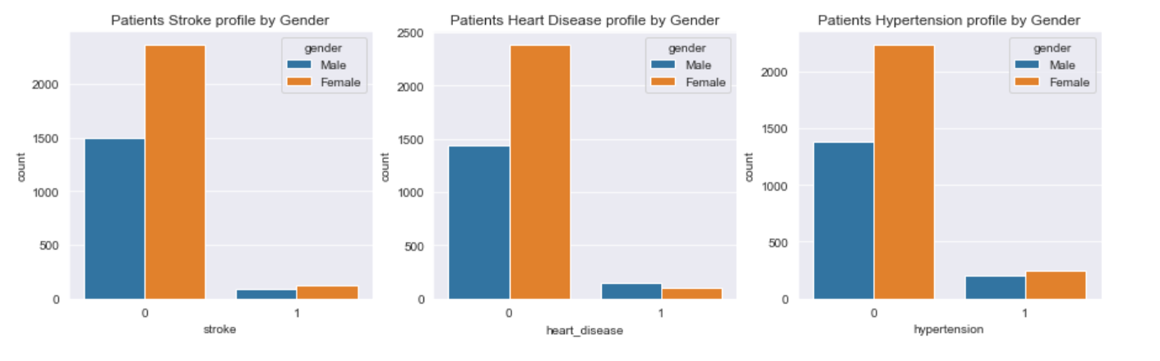
Exploratory Analysis - Bivariate Analysis
- The datasets seems to have a higher Female population than Males.
- More females have hypertension and stroke than males however more males suffer from heart disease

Slide 11
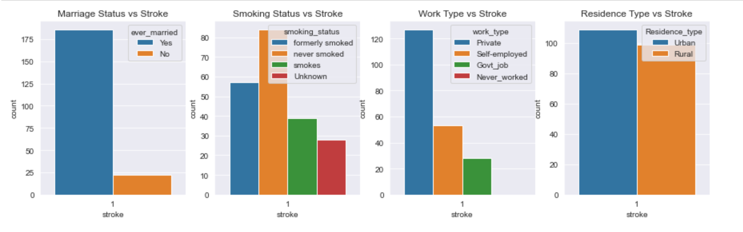
Categories of Patients who have Stroke
- The patients who were ever married suffered more from stroke and surprisingly the patients who have never smoked suffered more from stroke.
- Patients working private jobs had the highest percentage of the total stroke patients which can be related with the stress and pressure of running private businesses and the corresponding risks involved.
- While the margins are slim, the patients who resided in the urban areas had suffered stroke more than those in the rural areas.

Slide 12
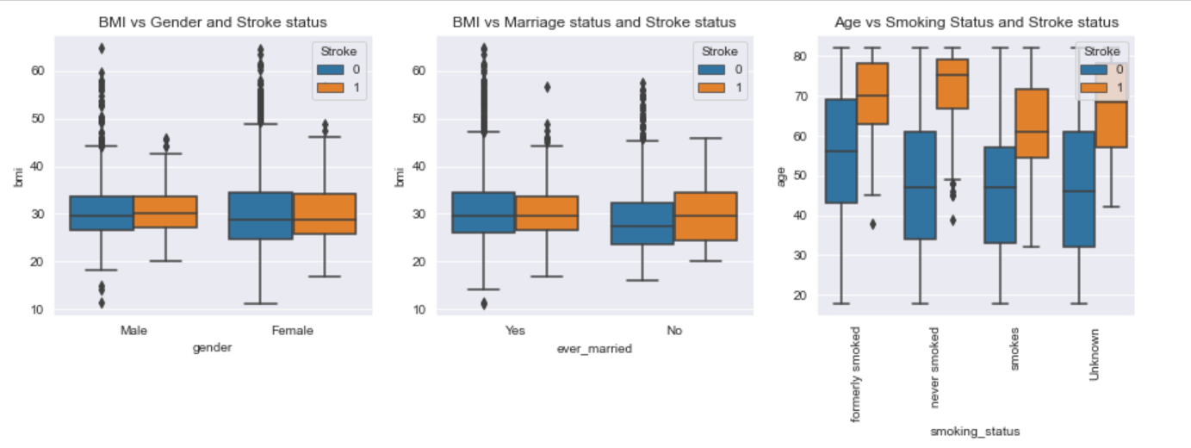
Exploratory Analysis - Multivariate Analysis
All the patients who had stroke were aged 32 or above while majority of the patients were within the age bracket of 55 - 80 years. The mean age for the patients who had never smoked is 76 years while for those who had smoked formerly it's 70 years hence it does not seem that the stroke would have been related to their smoking habits.
The male and female patients who had stroke were mostly obese as most of them had bmi values above 25 and mean BMI for males with stroke is 30 while for females it is slightly lower at 28. Obesity which is characterized by BMI obviously has some relationship to the chances of having stroke.

Slide 13
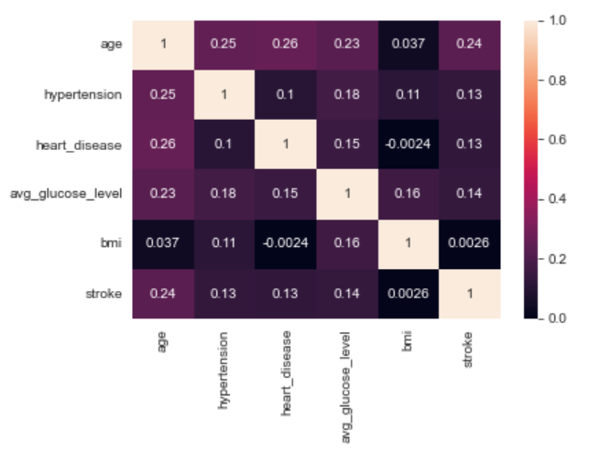
Plotting Correlation Between Featured And Labels
The Heatmap does not show any linear relationships between our features and label and the heatmap does not also show and tangible correlations between the features and the label or even among the features.
We can conclude from this that our model should not be a linear model rather a classification model hence we proceed with our proposed model.

Slide 14
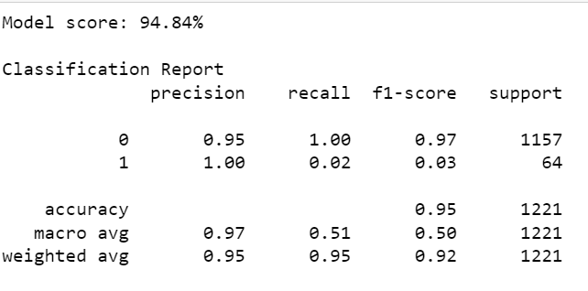
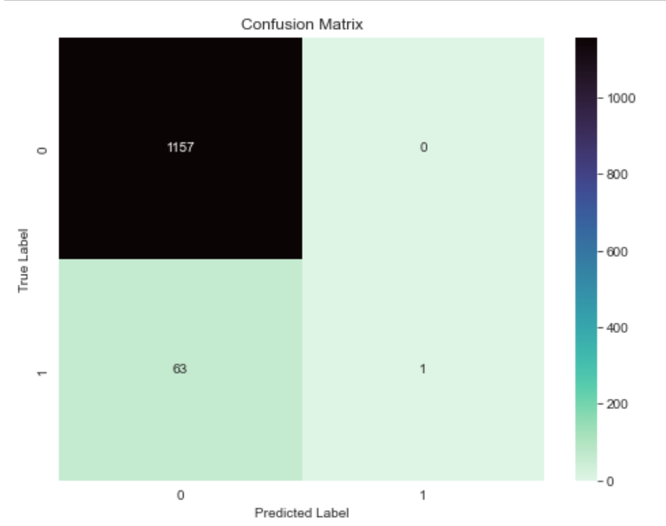
Model 1 Architecture and Summary
Classification model – Sklearn LogisticRegression()
Normalization – Sklearn StandardScalar()
Pipeline – Sklearn make_pipeline()
From the classification report it is obvious that this model is only predicting one class out of our two classes with class(1) having a score of almost 0 across recall and f1-score.

Slide 15
Model 1 Analysis
#Confirm if our data is balanced or imbalanced
y.value_counts()
Output:
0 3860
1 208
Name: stroke, dtype: int64
The data is clearly imbalanced as the class of '0' is more than 90% of entire data while class '1' is the minority class.
We have to oversample the minority class to balance our data to ensure that our model is not overfitting or biased.
- We will create a 2nd model with resampled data to see the impact of the resampling

Slide 16
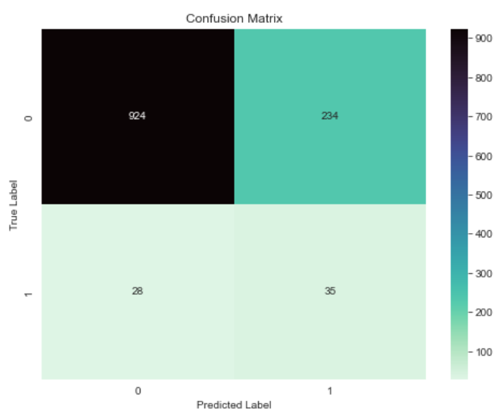
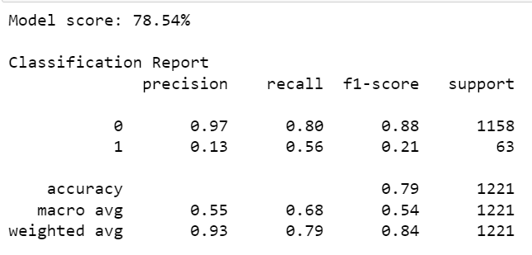
Model 2 Architecture and Summary
Classification model – Sklearn LogisticRegression()
Normalization – Sklearn StandardScalar()
Oversampling – imblearn.SMOTE()
Pipeline – imblearn make_pipeline()

Slide 17
Model 2 Analysis
This model without with resampling achieves an accuracy score of 78.54%.
From the recall statistics we can see the proportion of relevant instances of each class that were correctly identified by the model {'0' : 0.80 , '1': 0.56}.
From the precision score statistics, we can see the proportion of predicted positive instances that are actually positive {'0' : 0.97 , '1': 0.13}.
The f1-score which is a weighted average of precision and recall shows that our class 0 is at 0.21 which is still low but better than the previous score of 0.03 from model 1.
Overall, we would adopt this second model which is predicting both classes better.

Slide 18
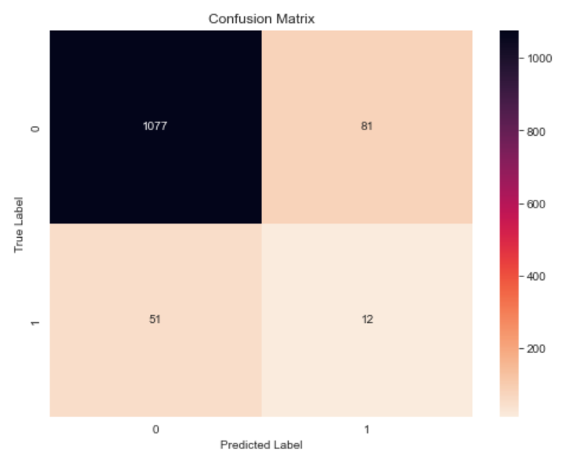
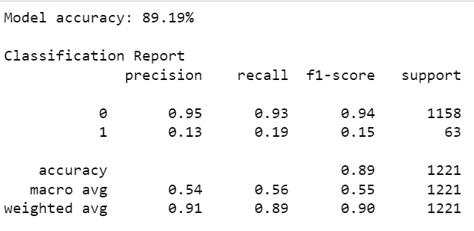
Model 3 Architecture and Summary
We created a 3rd model using a different classification model to compare the performance on the same data.
Classification model – Sklearn RandomForestClassifier()
Normalization – Sklearn StandardScalar()
Oversampling – imblearn.SMOTE()
Pipeline – imblearn make_pipeline()

Slide 19
Final conclusion
Comparing both models trained using the resampled data, we can see that the Random Forest model (89%) has better prediction accuracy than the Logistic Regression model (78%) on the test data.
Overall, the quality of the data used in training the models is poor and in order to achieve better training accuracies and prediction results we would explore one or all of the following:
Getting more data that has a better balance between patients who have stroke and those who do not have stroke.
Get additional features that have better relevance in predicting stroke occurrence in patients.

Slide 20
THANK YOU

